Slide 1
Windows: preparing the Anaconda Python environment
Alex Silva, Mohak Kant

Slide 2
1.1. Preparation if using an Nvidia GPU
if you don’t have a C/C++ compiler installed, download Visual Studio Community:
https://visualstudio.microsoft.com/vs/community
During the installation, select component C++ development and Windows 10 SDK (Version 10.0.15063.0 or newer)
If you have Visual Studio installed, find the Visual Studio Installer by typing “Visual Studio” on the search field in the Windows taskbar.
Then click on modify in the installer interface

Slide 3
1.2. Download and install Anaconda (64 bit for computers newer than 10 years-old)
https://www.anaconda.com/download/
Select “add Anaconda to path” during installation

Slide 4
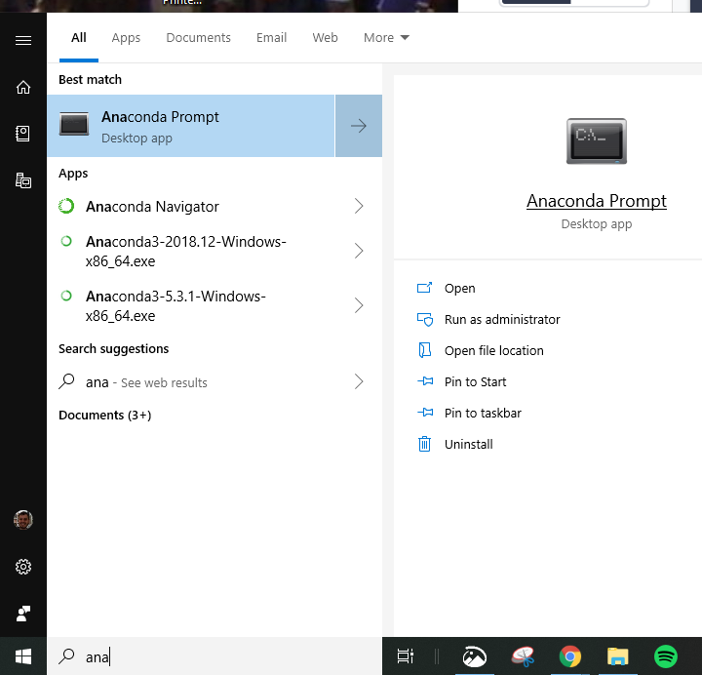
2. Change Anaconda’s Python from 3.7 to 3.6
tensorflow 1.12 is only compatible with Python 3.6
Press the Windows key on, and type in anaconda
similar to the pic on the right:
click with the mouse’s right button, and select Run as administrator
on the conda prompt, type in:
conda install python=3.6
it can take many minutes until the installation asks if you want to continue. As soon as it does, type in y.

Slide 5
3.1. Install keras + tensorflow with an Nvidia GPU
while still on the Anaconda Prompt (if closed, just run it again as administrator), type in
conda install tensorflow-gpu
and press enter. Confirm the installation with y and pressing Enter.
when the installation is finished, type in
conda install keras
press Enter, and confirm the installation.

Slide 6
3.2. Install keras + tensorflow without a GPU
while still on the Anaconda Prompt (if closed, just run it again as administrator), type in
conda install keras
And that’s it!

Slide 7
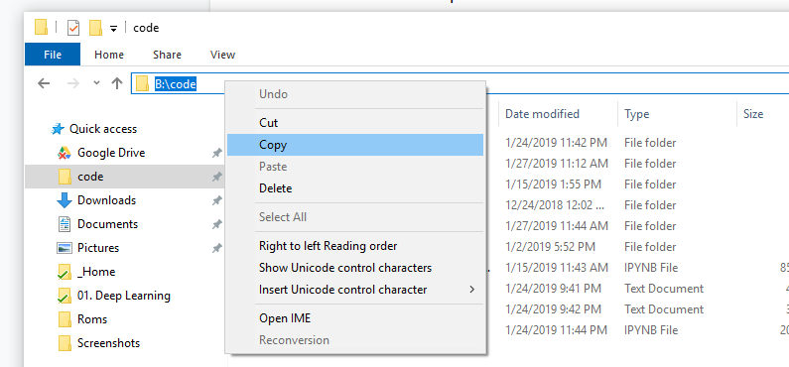
4. Change the Jupyter Notebook startup folder
Create a folder where you’d like to keep your machine learning code
Copy that folder’s path from the path bar on Windows Explorer

Slide 8
5. Change the Jupyter Notebook startup folder
3. Press the Windows key on your keyboard, and type in anaconda
4. When you see listed Anaconda Navigator, press your mouse’s right button and select Open file location
5. Right-click Juypter Notebook. Click on Properties.
6. On the field Target, find the last expression - it should look like this “%USERPROFILE\%”. Paste the path of you ML folder there, replacing everything between double quotes. Mine looks like “B:\code”

Slide 9
6. Download the example code
Clone this GitHub repo: https://github.com/mohakamg/python_ml_basics
copy the file Python_Basics_.ipynb to the folder where you’re machine learning code is going to be (Jupyter Notebook’s start folder)
to run Python_Basics_.ipynb, Jupyter notebook
press the Windows key and type on the search field Anaconda Navigator. Right-click on it and click on Open file location
Double click on Jupyter Notebook. It will run on web browser, showing the files in your ML folder
You should see the example file Python_Basics_.ipynb listed there, if you copied to the folder. Just click on its name to open it, and you’ll see the Jupyter Notebook environment

Slide 10
7. Useful links
GitHub repo with the Python example for this tutorial
https://github.com/mohakamg/python_ml_basics
Numpy for Matlab users:
https://docs.scipy.org/doc/numpy-1.15.0/user/numpy-for-matlab-users.html
Plots - from Matplotlib examples:
https://matplotlib.org/gallery/index.html
Keras example
https://github.com/tensorflow/docs/blob/master/site/en/tutorials/keras/basic_classification.ipynb

